Slide 1
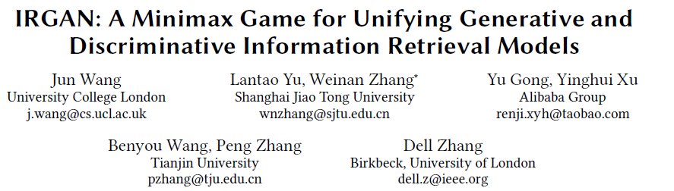
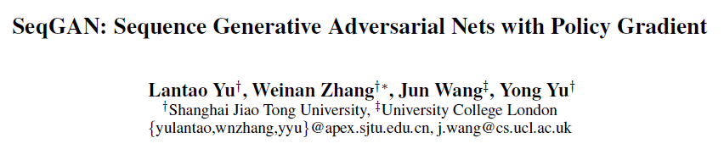
IRGAN: A Minimax Game for Unifying Generative and Discriminative Information Retrieval Models
Background
Author overlaps

Slide 2
IRGAN: A Minimax Game for Unifying Generative and Discriminative Information Retrieval Models
Background
以三个strong accepted (评分1-5，得分：5, 5, 5)的成绩被SIGIR 2017录取。
汪军说，“中英团队之间的 8 小时时差对我们快速迭代是有利的，英国的工作在深夜结束后，直接提交给中国的团队（已经是中国的第二天清晨）。中国的团队结束后，又可以交给英方。我们基本上是 24 小时不停的快速迭代，保证工作的质量和速度。”
“整个团队8个人在 bitbucket 上面提交论文 latex 修改，借助 git 强大的修改 merge 功能，我们总是能多人并行迭代论文工作。在最后的 1 月 24 日那一天，我们的提交次数就超过了 200 次，这个项目的总提交数则在 550 次。”

Slide 3
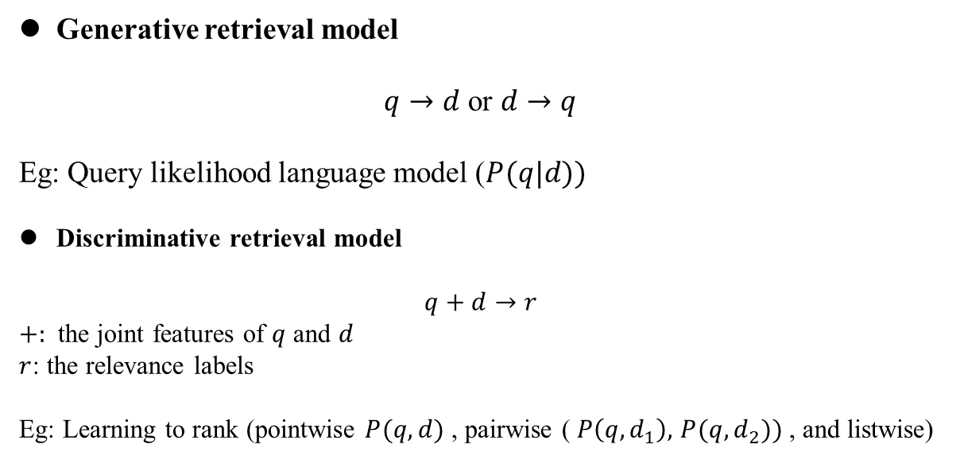
IRGAN: A Minimax Game for Unifying Generative and Discriminative Information Retrieval Models
Introduction
Generative retrieval model
$q→d$ or $d→q$
Eg: Query likelihood language model ($P(q|d))$
Discriminative retrieval model
$$q+d→r$$
$+:$ the joint features of $q$ and $d$
$r$: the relevance labels
Eg: Learning to rank (pointwise $P(q,d)$ , pairwise ( $P\left(q,d_{1}\right),$ $P(q,d_{2}))$ , and listwise)

Slide 4
IRGAN: A Minimax Game for Unifying Generative and Discriminative Information Retrieval Models
Introduction
Generative retrieval model
Focus on text statistics and distributions over document space.
Difficult to use the relevancy signals such as links, clicks etc, which are largely observable in Internet-based applications.
Unify them with GAN (IRGAN)
Discriminative retrieval model
Can learn a ranking function based on the features from a large amount of labeled data.
Rely on labeled data and difficult to obtain useful features or gathering helpful signals from the massive unlabeled data.

Slide 5
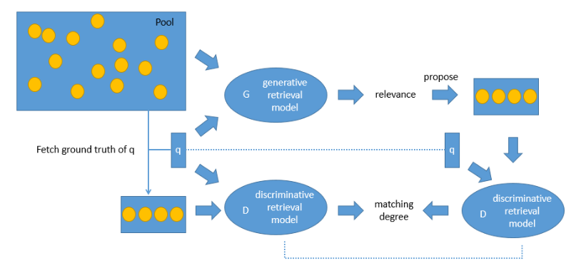
IRGAN: A Minimax Game for Unifying Generative and Discriminative Information Retrieval Models
Introduction
IRGAN
Both generative and/or discriminative models are useful for three IR typical applications: web search, item recommendation, and question answering.

Slide 6
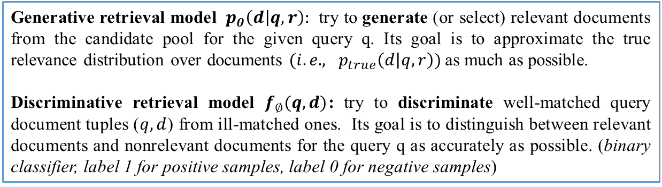
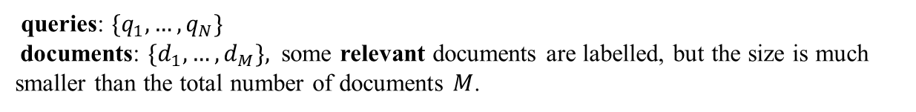
IRGAN: A Minimax Game for Unifying Generative and Discriminative Information Retrieval Models
IRGAN Formulation
queries: ${\{q}_{1},…,q_{N}\}$
documents: ${\{d}_{1},…,d_{M}\},$ some relevant documents are labelled, but the size is much smaller than the total number of documents $M$.
True relevance distribution${ : p}_{true}\left(d | q,r\right)$, depicts the relevance preference distribution over the candidate documents with respect to the submitted query.
Generative retrieval model ${ p}_{θ}\left(d | q,r\right):$ try to generate (or select) relevant documents from the candidate pool for the given query q. Its goal is to approximate the true relevance distribution over documents ${(i.e., p}_{true}\left(d | q,r\right))$as much as possible.
Discriminative retrieval model $f_{∅}(q,d)$: try to discriminate well-matched query document tuples ($q,d$) from ill-matched ones. Its goal is to distinguish between relevant documents and nonrelevant documents for the query q as accurately as possible. (binary classifier, label 1 for positive samples, label 0 for negative samples)
Note: documents could be textual documents, items, or answers, depending on the specific retrieval task.

Slide 7
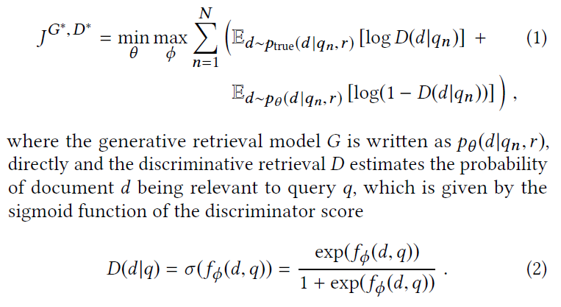
IRGAN: A Minimax Game for Unifying Generative and Discriminative Information Retrieval Models
IRGAN Formulation
Overall Objective
The optimal parameters of the generative retrieval model and the discriminative retrieval model can be learned iteratively by maximising and minimising the same objective function respectively.

Slide 8
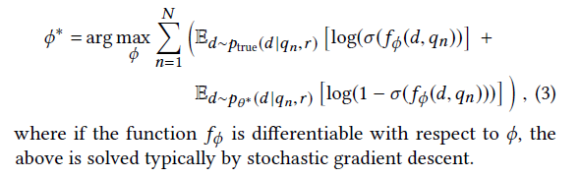
IRGAN: A Minimax Game for Unifying Generative and Discriminative Information Retrieval Models
IRGAN Formulation
Optimizing Discriminative Retrieval
The objective for the discriminator is to maximise the log-likelihood of correctly distinguishing the true and generated relevant documents.

Slide 9
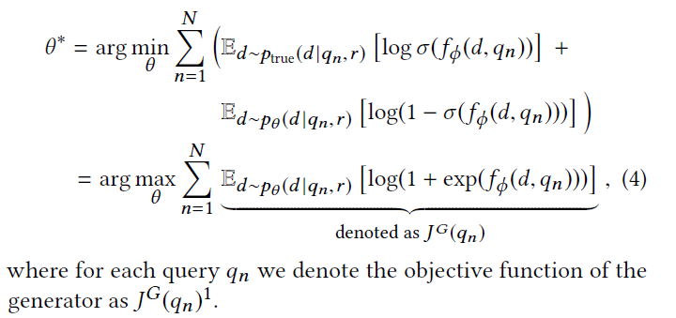
IRGAN: A Minimax Game for Unifying Generative and Discriminative Information Retrieval Models
IRGAN Formulation
Optimizing Generative Retrieval
The generative retrieval model intends to minimise the objective; it randomly samples documents from the whole document set to fool the discriminative retrieval model.
Unlike GAN, the generative model here directly generates known documents not their features, because the work here intends to select relevant documents from a given document pool.

Slide 10
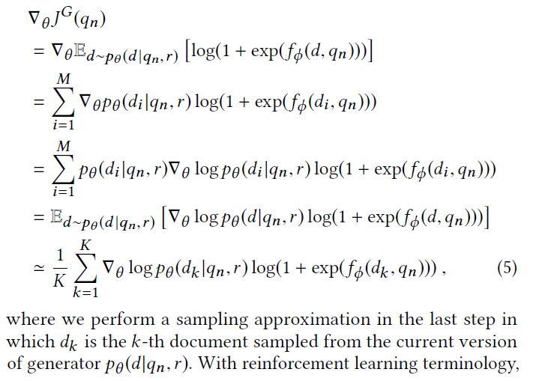
IRGAN: A Minimax Game for Unifying Generative and Discriminative Information Retrieval Models
IRGAN Formulation
Optimizing Generative Retrieval
As the sampling of d is discrete, it cannot be directly optimized by gradient descent as in the original GAN formulation. The policy gradient based reinforcement learning is used:

Slide 11
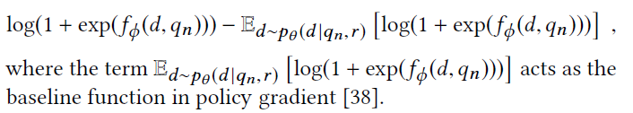
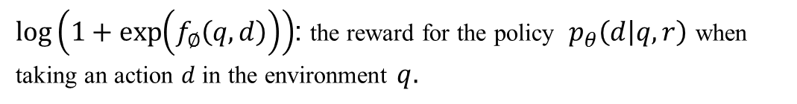
IRGAN: A Minimax Game for Unifying Generative and Discriminative Information Retrieval Models
IRGAN Formulation
Optimizing Generative Retrieval
$\log\left(1+\exp\left(f_{∅}\left(q,d\right)\right)\right)$: the reward for the policy ${ p}_{θ}\left(d | q,r\right)$ when taking an action $d$ in the environment $q.$
In order to reduce variance during the REINFORCE learning, the reward term is replaced by its advantage function:

Slide 12
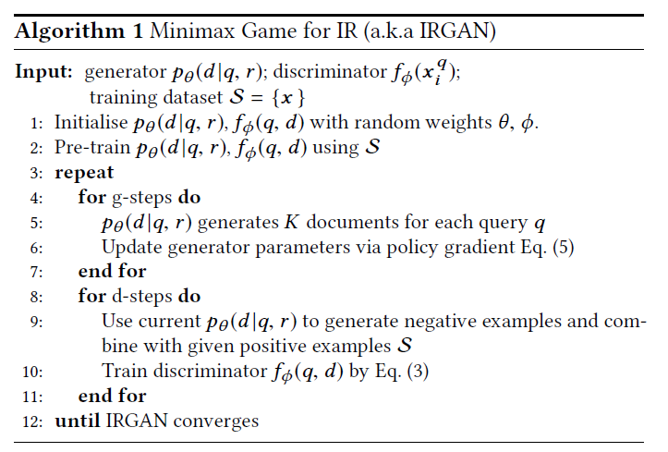
IRGAN: A Minimax Game for Unifying Generative and Discriminative Information Retrieval Models
IRGAN Formulation
Overall logic (algorithm)

Slide 13
IRGAN: A Minimax Game for Unifying Generative and Discriminative Information Retrieval Models
Extension to Pairwise Case
It is often easier to capture users’ relative preference judgements on a pair of documents than their absolute relevance judgements on individual documents (e.g., from a search engine’s click-through log).
Thus, in many IR problems, the training data is not a set of relevant documents, but a set of ordered document pairs for each query.
For each query $q_{n}$, a set of labeled document pairs $R_{n}=\{<d_{i}, d_{j}>|d_{i}≻d_{j}\}$, where $d_{i}≻d_{j}$ means${ d}_{i}$ is more relevant to $q_{n}$ than $d_{j.}$

Slide 14
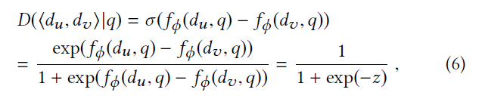

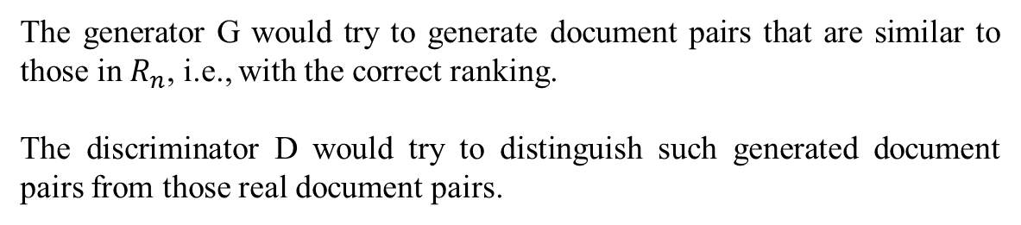
IRGAN: A Minimax Game for Unifying Generative and Discriminative Information Retrieval Models
Extension to Pairwise Case
For each query $q_{n}$, a set of labelled document pairs $R_{n}=\{<d_{i}, d_{j}>|d_{i}≻d_{j}\}$, where $d_{i}≻d_{j}$ means${ d}_{i}$ is more relevant to $q_{n}$ than $d_{j}$.
The generator G would try to generate document pairs that are similar to those in $R_{n}$, i.e., with the correct ranking.
The discriminator D would try to distinguish such generated document pairs from those real document pairs.

Slide 15
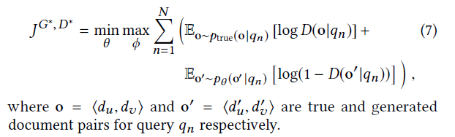
IRGAN: A Minimax Game for Unifying Generative and Discriminative Information Retrieval Models
Extension to Pairwise Case
If we use the standard cross entropy cost for this binary classifier as before, we have the following minimax game:

Slide 16
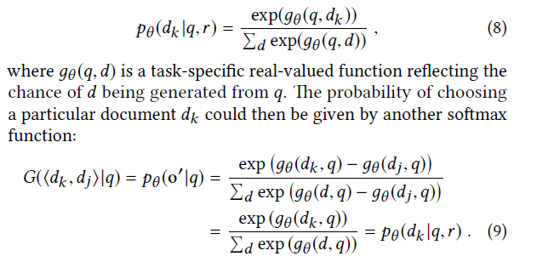
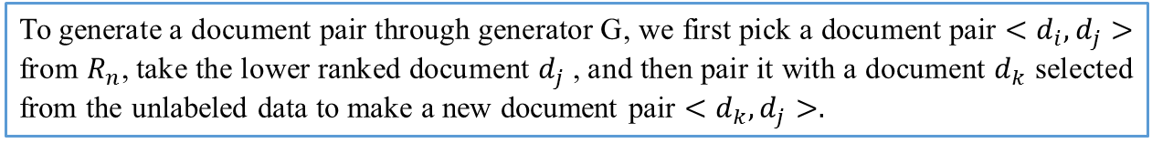
IRGAN: A Minimax Game for Unifying Generative and Discriminative Information Retrieval Models
Extension to Pairwise Case
To generate a document pair through generator G, we first pick a document pair $<d_{i}, d_{j}>$ from $R_{n}$, take the lower ranked document $d_{j}$ , and then pair it with a document $d_{k}$ selected from the unlabeled data to make a new document pair $<d_{k}, d_{j}>.$
Suppose that the generative model ${ p}_{θ}\left(d_{k} | q,r\right)$ is given by a softmax function:
In this special case, $G(<d_{i}, d_{j}>|q$) happens to be ${ p}_{θ}\left(d_{k} | q,r\right)$.

Slide 17


IRGAN: A Minimax Game for Unifying Generative and Discriminative Information Retrieval Models
Applications
$τ:$Temperature parameter
Although there could be various implementations for g and f , to focus more on adversarial training, they implement them using the same function (with different sets of parameters):

Slide 18
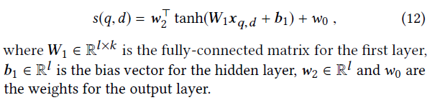
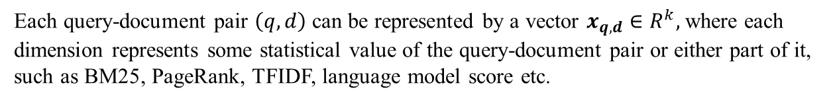
IRGAN: A Minimax Game for Unifying Generative and Discriminative Information Retrieval Models
Applications
Web Search
Each query-document pair $\left(q,d\right)$can be represented by a vector $x_{q,d}∈R^{k},$where each dimension represents some statistical value of the query-document pair or either part of it, such as BM25, PageRank, TFIDF, language model score etc.
A two-layer neural network for the score function:

Slide 19
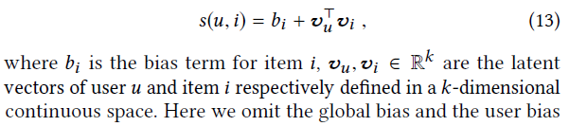
IRGAN: A Minimax Game for Unifying Generative and Discriminative Information Retrieval Models
Applications
Item Recommendation
Matrix factorization (Collaborative filtering)

Slide 20

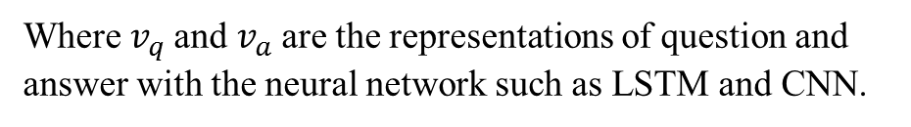
IRGAN: A Minimax Game for Unifying Generative and Discriminative Information Retrieval Models
Applications
Question Answering
Where $v_{q}$and $v_{a}$are the representations of question and answer with the neural network such as LSTM and CNN.

Slide 21
IRGAN: A Minimax Game for Unifying Generative and Discriminative Information Retrieval Models
Experiments
Web Search
Dataset : MQ2008-semi (Million query track), which contains a large amount
of unlabeled data.
Each query-document pair in the dataset is given a relevance level (-1, 0, 1 or 2).
(-1 means “unknown”).
Samples: Positive samples: 1 and 2; Unlabeled samples: 0 and -1.
Each query-document pair is represented by a 46-dimensional vector of features (such as BM25 and LMIR).
Use the generator in pointwise IRGAN and discriminator in pairwise IRGAN for web search.

Slide 22
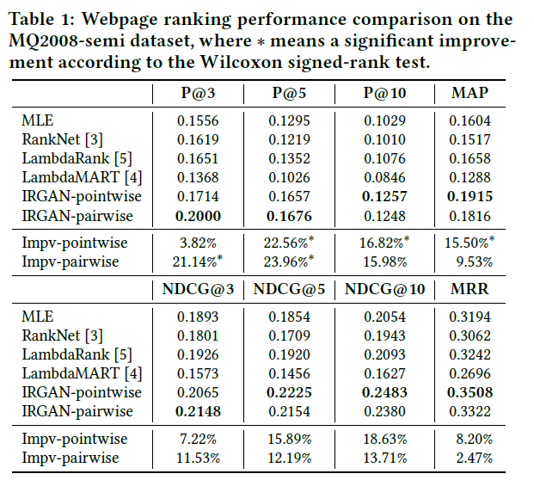
IRGAN: A Minimax Game for Unifying Generative and Discriminative Information Retrieval Models
Experiments
Web Search

Slide 23
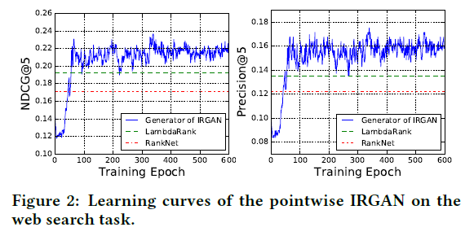
IRGAN: A Minimax Game for Unifying Generative and Discriminative Information Retrieval Models
Experiments
Web Search
After about 150 epoches for IRGAN-pointwise and 60 epochs for IRGAN-pairwise of adversarial training, both Precision@5 and NDCG@5 converge and the winner player consistently outperforms the best baseline LambdaRank.

Slide 24
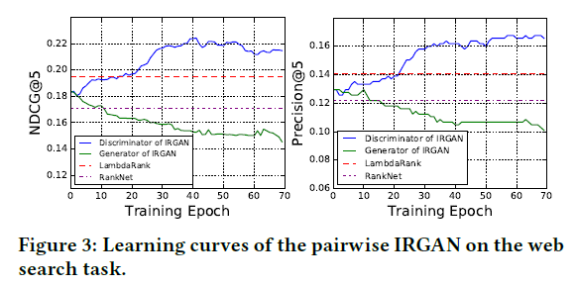
IRGAN: A Minimax Game for Unifying Generative and Discriminative Information Retrieval Models
Experiments
Web Search
After about 150 epoches for IRGAN-pointwise and 60 epochs for IRGAN-pairwise of adversarial training, both Precision@5 and NDCG@5 converge and the winner player consistently outperforms the best baseline LambdaRank.

Slide 25
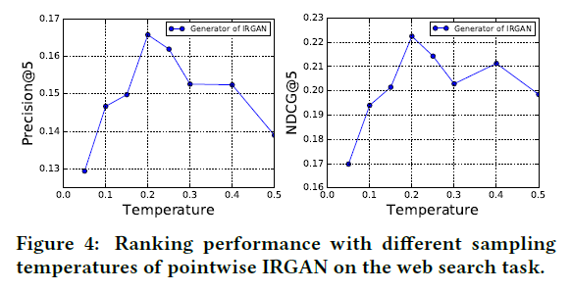
IRGAN: A Minimax Game for Unifying Generative and Discriminative Information Retrieval Models
Experiments
Web Search

Slide 26
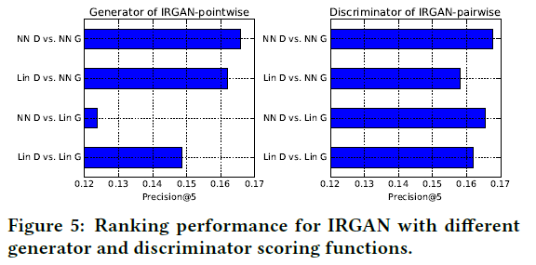
IRGAN: A Minimax Game for Unifying Generative and Discriminative Information Retrieval Models
Experiments
Web Search
NN: two layer neural network , Lin: linear model
This suggests that the model used for making the prediction (the generator in IRGAN-pointwise or the discriminator in IRGAN-pairwise) should be implemented with a capacity not lower than its opponent.

Slide 27
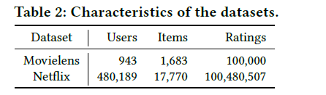
IRGAN: A Minimax Game for Unifying Generative and Discriminative Information Retrieval Models
Experiments
Item Recommendation
Samples: Positive samples : 5-star ratings; Unlabeled samples: the other ratings
The factor numbers for matrix factorization are 5 and 16 for Movielens and Netflix respectively.h
Use the generator of pointwise IRGAN since the rank is not so important in recommendation.

Slide 28
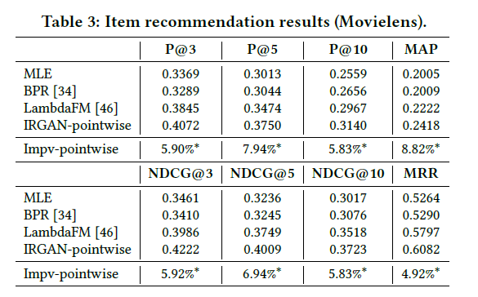
IRGAN: A Minimax Game for Unifying Generative and Discriminative Information Retrieval Models
Experiments
Item Recommendation
Note that the generative retrieval model in IRGAN does not explicitly learn to optimise the ranking measures like what LambdaFM does, it still performs consistently better than LambdaFM. Our explanation is that the adversarial training provides both models a higher learning flexibility than the single-model training of LambdaFM or BPR.

Slide 29
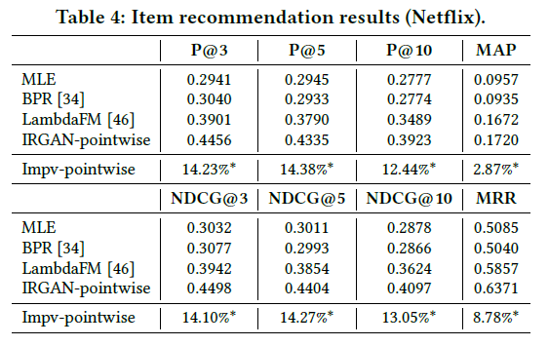
IRGAN: A Minimax Game for Unifying Generative and Discriminative Information Retrieval Models
Experiments
Item Recommendation
Note that the generative retrieval model in IRGAN does not explicitly learn to optimise the ranking measures like what LambdaFM does, it still performs consistently better than LambdaFM. Our explanation is that the adversarial training provides both models a higher learning flexibility than the single-model training of LambdaFM or BPR.

Slide 30
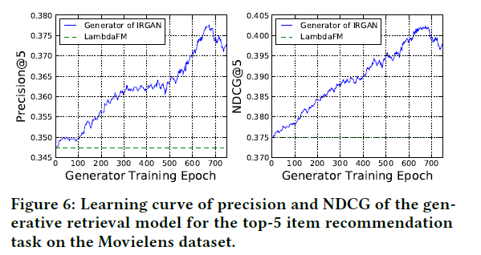
IRGAN: A Minimax Game for Unifying Generative and Discriminative Information Retrieval Models
Experiments
Item Recommendation
IRGAN owns a consistent superiority over the baseline LambdaFM from the beginning of adversarial training.

Slide 31
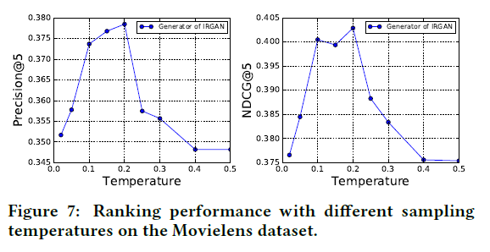
IRGAN: A Minimax Game for Unifying Generative and Discriminative Information Retrieval Models
Experiments
Item Recommendation
The optimal temperature parameter is consistent with that in web search.

Slide 32
IRGAN: A Minimax Game for Unifying Generative and Discriminative Information Retrieval Models
Experiments
Question Answering
Datasest: Insurance QA
(The candidate answers are usually randomly sampled from the whole answers pool. In practice, 500 candidate answer are used for each question due to the time complexity, which is still larger than other QA datasets. Thus, InsuranceQA is suitable for testing the sampling/generating strategy.)
Samples: Positive samples: the only one right answer and the question;
Unlabeled samples: the other (q, a) pairs
Task: Find the one and only real answer from 500 candidate answers under the Precision@1 metric.
Use the pairwise IRGAN, since it works better for top ranked documents in web search.

Slide 33
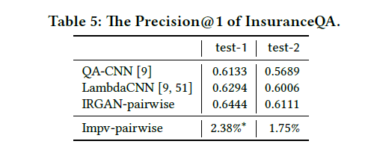
IRGAN: A Minimax Game for Unifying Generative and Discriminative Information Retrieval Models
Experiments
Question Answering

Slide 34
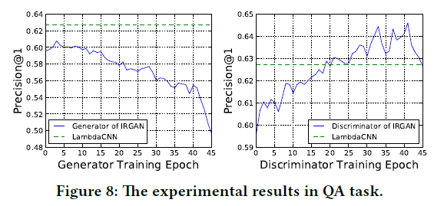
IRGAN: A Minimax Game for Unifying Generative and Discriminative Information Retrieval Models
Experiments
Question Answering
Test-1 set:
The performance of the discriminative retrieval model in IRGAN-pairwise is better than LambdaCNN, while the generative retrieval model tends to perform less effectively during the pairwise adversarial training.
This may be caused by the data sparsity problem (each question usually has only one correct answer and many more weak negative answers), the generator may fail to get a positive feedback from the discriminator.

Slide 35
IRGAN: A Minimax Game for Unifying Generative and Discriminative Information Retrieval Models
Conclusions
Propose the IRGAN framework that unifies two schools of information retrieval methodologies, i.e., generative models and discriminative models, via adversarial training in a minimax game.
The generative retrieval model is guided by the signals obtained from the discriminative retrieval model, which makes it more favourable than the non-learning methods or the maximum likelihood estimation scheme.
The discriminative retrieval model could be enhanced to rank top documents better via strategic negative sampling from the generator.
In the pointwise version of IRGAN, the generative retrieval model gets improved more than the discriminative retrieval model, but we have an opposite observation in the pairwise case.

